Slide 1
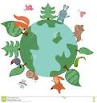
Year R
Summer Term Information
Mathematics
Counting, reciting and recognising patterns in numbers to 20 and beyond
Naming, recognising and manipulating 2D and 3D shapes
Investigating symmetry
Addition/subtraction- adding groups, working out how many have been added or taken away
Sharing and making groups
Spatial awareness, including position and simple maps/plans
Repeated patterns
Cheddington Combined School
Literacy
Reading
The children will continue to take home a number of books each week
Regular reading at home will enable your child to make more progress
Please continue to send reading folders in EVERYDAY
As their reading develops, please ensure that you ask questions about what they have read, so they can show they understand the text There are suggested questions and other activities at the end or beginning of the books
Please continue to practise the tricky words
Phonics
The children will be revising Phase 3, to ensure that they are secure with these sounds for reading and writing. We will then start Phase 4, which introduces no new sounds, but has more tricky words to learn and focuses on blending and spelling words with adjacent consonants e.g. clip, blunt, stair
Writing
Handwriting patterns and letters
Writing different things- captions, labels, postcards, news
Super sentences most mornings, where the children will have a sentence to copy and complete
Writing longer sentences and extended pieces
Summer 1- Creep Crawl and Wriggle
Ready Steady Grow
Mini-beasts- naming, finding, drawing and describing
Butterflies- life cycle
Plants, seeds and farming
Summer 2- On the Beach
Under the sea- animals in the sea
Pirates- life on a pirate ship and treasure maps
Holidays in the past
Creative development
Observational drawings of plants and animals
Collage work
Spider’s webs
Butterfly art
Painting the sea
Flower art
Understanding the World
Where do insects live?
How can we sort and describe insects?
Life cycle of a caterpillar
How do we look after and appreciate the natural environment?
Where does food come from?
How do we grow food?
How was food grown in the past?
Which creatures are found in the sea and on the seashore?
Physical Development
Physical development
PE is on Monday and Friday
Ball skills through tennis
Athletics
The children will also be able to use equipment in the outside area
We are also hoping that all the children will learn to ride the pedal bike this term (if they cannot already)

Slide 2
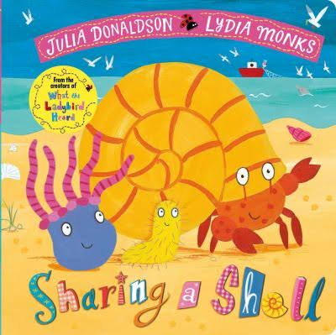
Year R
Summer Term Information
Useful Reminders
Long hair should be tied back
Named water bottle in class everyday
During the morning session each child can choose to have a snack and some milk
Please let your child know if they have a letter or note and to hand it into us. This will help to develop their independence, ready for Y1.
If the children do not have trainers for PE, these would be useful. They can be any colour, BUT PLEASE NO LACES
Also tracksuit trousers (joggers) for PE
Please check labels in clothes are still clear (We have a growing number of unnamed items which we cannot return)
Library book returned to school on a Tuesday
Please return reading folders on a Monday. New books will be sent home on Tuesdays
Cheddington Combined School
Learning at Home
Reading
Children should be reading their reading books at home as often as possible. Reading for 5 minutes everyday, is often better than reading once for longer. Remember that is important for the children to re-read books to gain fluency and understanding. Please support your child with their reading. It makes such a difference
Home Learning Challenges
We will continue to send home activities for you to do at home if you wish to. These will be linked to the learning in class.
We will look at these if they are brought into school.
Weekly Advanced Organiser
Please use this to support you in talking to your child about what they might have been learning at school. This will enable them to show you what they know and to extend and embed their learning.
Texts we will be using this term will include
Websites to Support Learning
https://www.bbc.co.uk/bitesize/subjects/zphybqt
https://www.bbc.co.uk/bitesize/subjects/zhtf3j6
https://www.phonicsbloom.com/uk/game/list/phonics-games-phase-3
https://www.bbc.co.uk/cbeebies/shows/mini-beast-adventure-with-jess
https://www.woodlandtrust.org.uk/blog/2019/06/minibeast-activities-crafts/
Trips and visits
College Lake 24th April
The History Man 19th June (Castles, to revise previous learning)

